Slide 1


SMART INDIA HACKATHON 2026
Problem Statement ID - SIH26198
Problem Statement Title - Student Innovation-Cutting-edge technology in these sectors continues to be in demand. Recent shifts in healthcare trends, growing populations also present an array of opportunities for innovation
Theme - MedTech / BioTech / HealthTech
PS Category - Software
Team ID -
Team Name - HyperLuma
AI-assisted screening / decision support
—

Slide 2
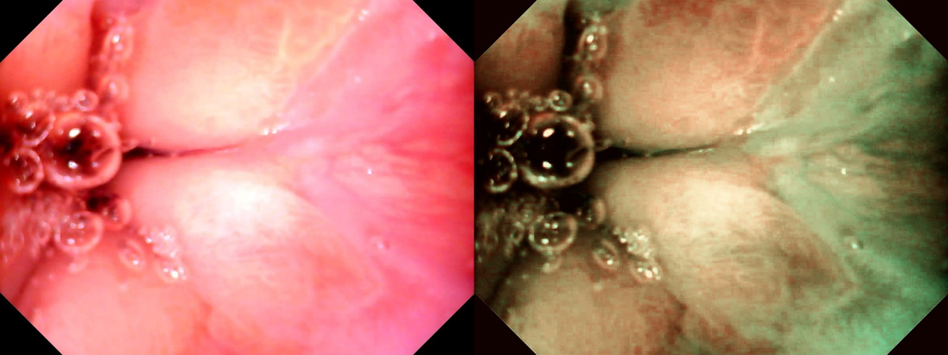
SAVE (Spectrum-Aided Vision Enhancer)
HYPERLUMA
WLI
SAVE Image
Reports indicate that inexperienced endoscopists show significantly lower diagnostic sensitivity, sometimes as low as 53% under narrow-band imaging for high-grade squamous intraepithelial lesions, which indicates that white light imaging would report even lower sensitivity [1].
According to a survey, only 58.5% of endoscopists had received training in the detection of premalignant upper gastro‐intestinal lesions.
The 5-year survival rate for Esophageal cancer is around 20% which makes early detection even more crucial [2].
Video Capsule Endoscopy is a emerging non-invasive technology, but it’s major flaw is the size constrain, which does not allow hardware integration of NBI [3].
Therefore in this study we have developed a software based alternative called SAVE (Spectrum-Aided Vision Enhancer) for reconstructing NBI using hyperspectral imaging.
SAVE algorithm enhances endoscopic diagnosis by converting white light images to informative wavelengths, improving contrast for better tissue and abnormality detection. It enables medical professionals to make more accurate diagnoses, identifying early-stage issues and hidden structures, while reducing the need for invasive interventions, ultimately improving patient outcomes in gastroenterology and other medical specialties

Slide 3
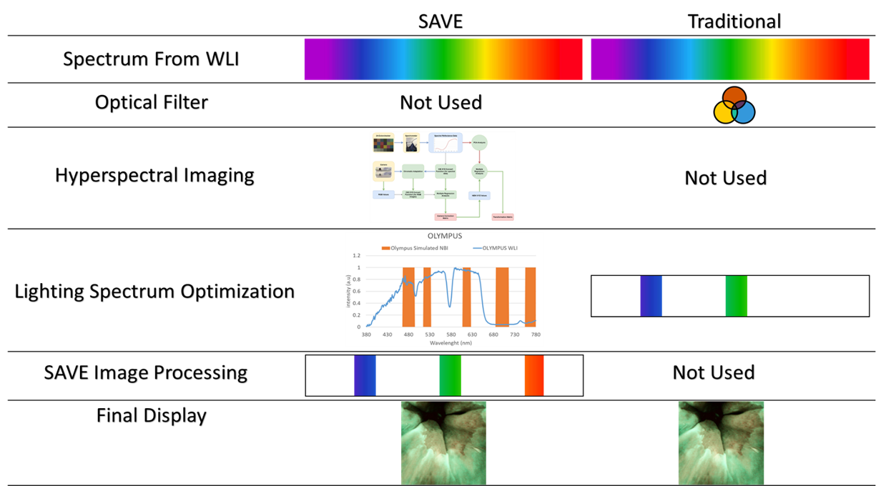
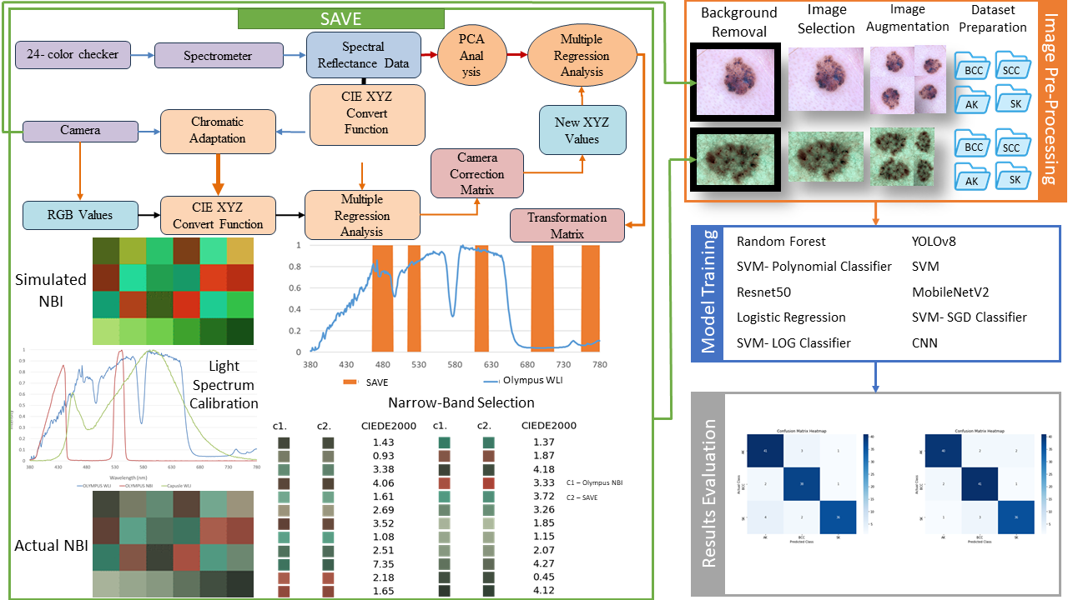
TECHNICAL APPROACH
HYPERLUMA
Python (OpenCV, NumPy, scikit-learn) for the SAVE spectral-reconstruction pipeline; CIE XYZ / CIEDE2000 colour science with PCA-based band selection; DL/ML stack – YOLOv3–v11, SSD, Faster R-CNN, CNN, MobileNet, VGG, ResNet, InceptionV3, EfficientNet, SVM, Random Forest, XGBoost/LightGBM; packaged as a Windows desktop CAD application.

Slide 4
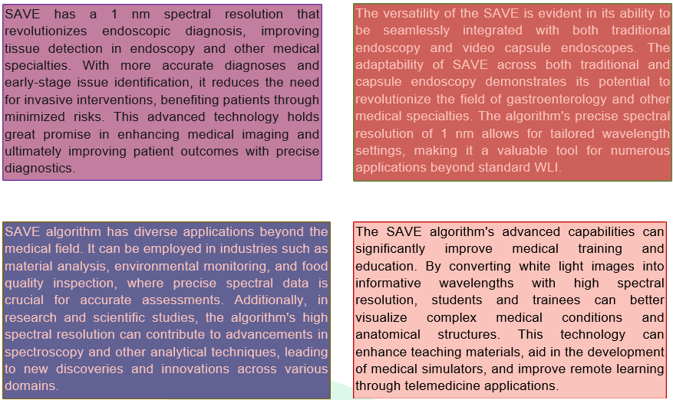
FEASIBILITY AND VIABILITY
HYPERLUMA
Software-Based Solution: No additional NBI hardware is required; SAVE works with existing WLI systems.
Cost-Effective: Reduces the need for dedicated NBI equipment and additional clinical infrastructure.
Technically Feasible: Uses established technologies including Python, OpenCV, PCA, CIE colour science and deep learning.
Validated Approach: Tested on gastrointestinal and esophageal datasets from Kaohsiung Medical University.
Easy Deployment: Can be packaged as a Windows desktop application for integration into existing clinical workflows.
Scalable: More clinical datasets can be incorporated through collaborations with hospitals and medical institutions.

Slide 5
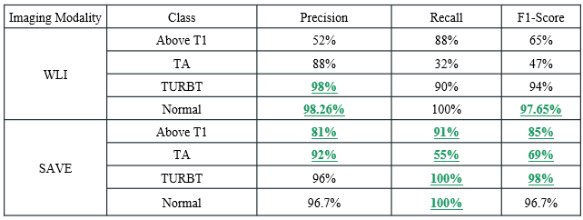
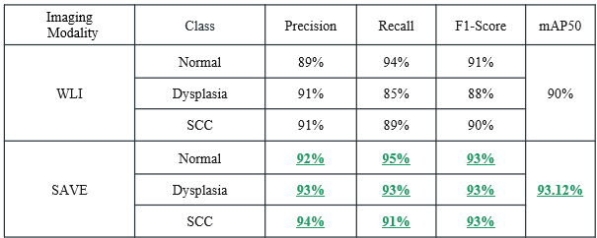
IMPACT AND BENEFITS
HYPERLUMA
Allows early detection of cancer for doctors and patients, which has a significant impact on mortality.
Enables early detection of non-invasive of esophageal, skin, bladder, etc cancers for patients in low-resource areas.
Clinically : SAVE images consistently improve the detection/classification accuracy over the plain White Light Images.
Ex- 93% for WLI then 97% for SAVE images
Social : Faster diagnosis, and support for rural / low resource hospitals lacking with dedicated NBI hardware.
Economic: No new hardware required: SAVE is a software which is a upgrade to the existing endoscopic,
infrastructural, lowering the cost of cancer screening.
Educational: Good spectral visualization of tissue improves the medical training, simulation and telemedicine
materials.
Bladder Cancer
Esophageal Cancer

Slide 6
RESEARCH AND REFERENCES
HYPERLUMA
[1] Li, Bing, et al. "Effect of computer aided detection system on esophageal neoplasm diagnosis in varied levels of endoscopists." NPJ Digital Medicine 8.1 (2025): 160.
[2] Siegel, Rebecca L., et al. "Cancer statistics, 2022." CA: a cancer journal for clinicians 72.1 (2022): 7.
[3] Su, Chang-Chao, et al. "Capsule endoscopy: Current trends, technological advancements, and future perspectives in gastrointestinal diagnostics." Bioengineering 12.6 (2025): 613.
[4] Wang, Yen-Po, et al. "Spectrum aided vision enhancer enhances mucosal visualization by hyperspectral imaging in capsule endoscopy." Scientific reports 14.1 (2024): 22243.
[5] Wang, H.-C., Tsao, Y.-M., & Mukundan, A., “Method for Converting Endoscope Images to Narrow Band Images,” U.S. Patent US12602843B2, 2026. Patent record

